Slide 1
Social Media Analytics on Aerated Drinks
Given By:
Hai Ngoc Nguyen – BJ19BDS003
Rithwik Chhugani – BS18BDS008
Gautam Sadarangani – BS18BDS015

Slide 2
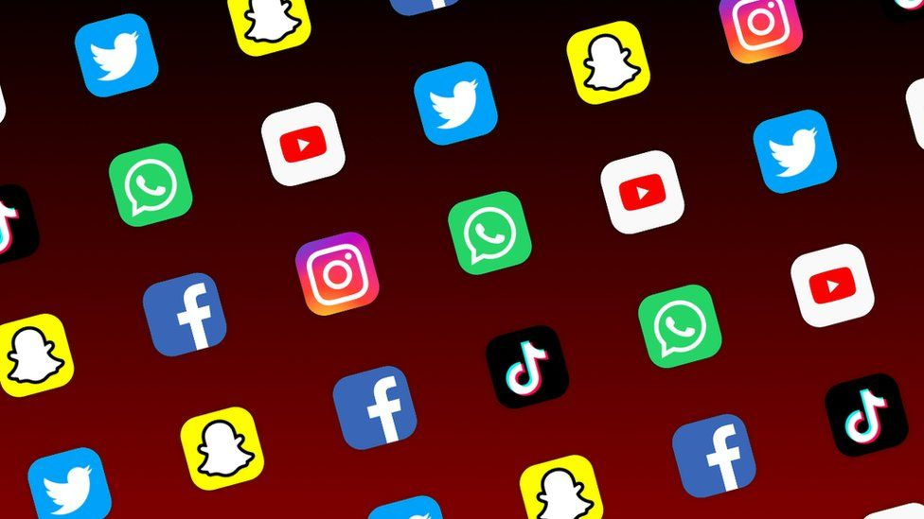



Introduction

Slide 3
Objectives & Goals
Understand how to collect data from 3 mentioned platform and the implementation of API if applicable.
Evaluate the quality of collected data.
Understand how active each brand is on these platforms.
Understand the pattern of how posts are distributed.
Get interaction statistics (like, share, comment, …) of posts on each platform.
Understand the popularity of each brands based on interaction on posts.
Understand customers perspective towards brands by analyzing comments.

Slide 4
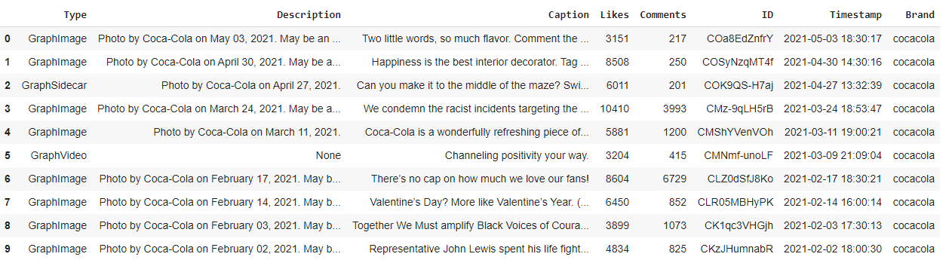
Instagram
COLLECTING DATA:

Slide 5
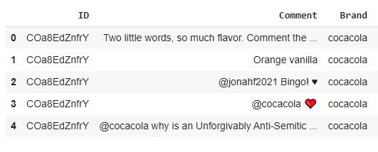
Instagram

Slide 6
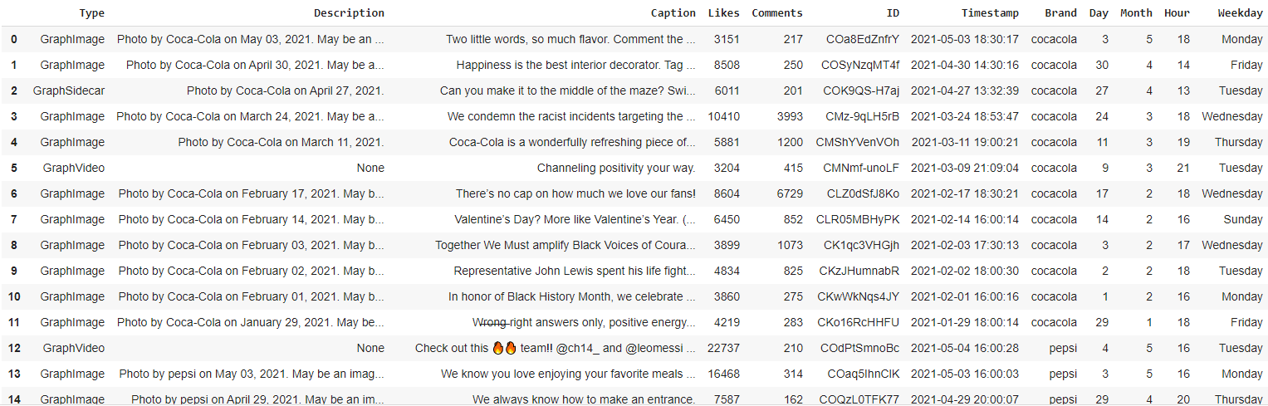
Instagram
PROCESSING DATA:

Slide 7
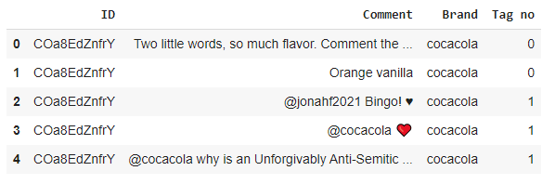
Instagram

Slide 8
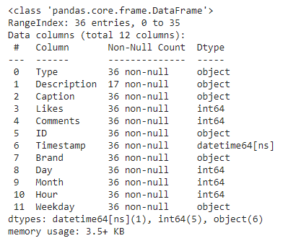
Instagram
INSPECTING DATA:
We have 3 different types of media on Instagram, namely GraphImage (single image), GraphSideCar (multiple images/videos) and GraphVideo (video). We have missing value for Description as media of type GraphVideo does not have description.

Slide 9
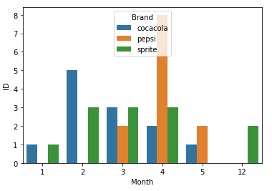
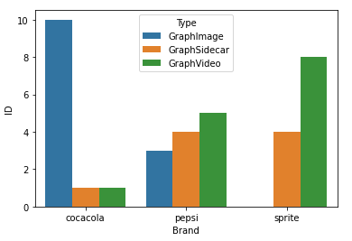
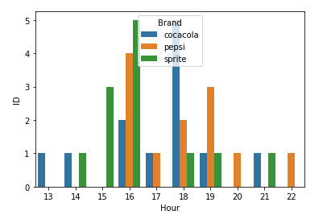
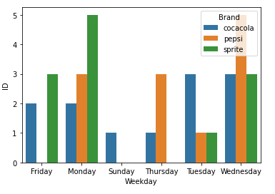
Instagram
ANALYZING DATA:

Slide 10
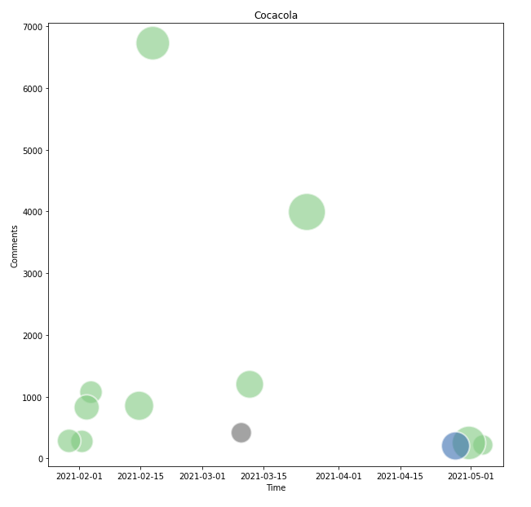
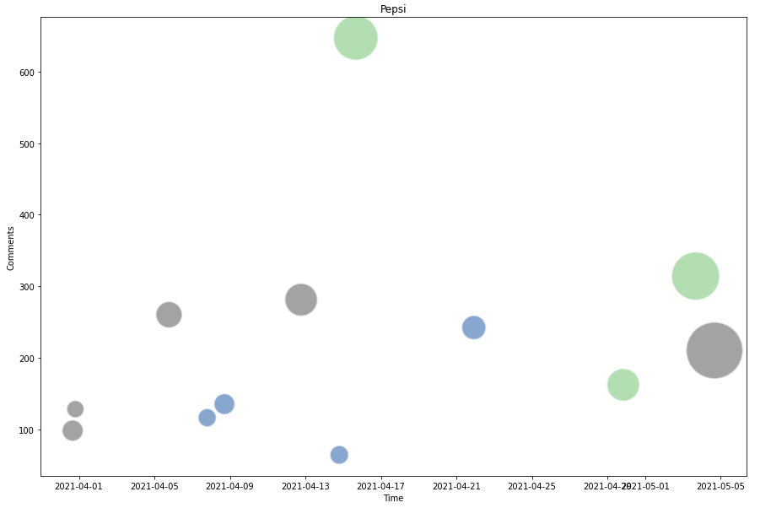
Instagram

Slide 11
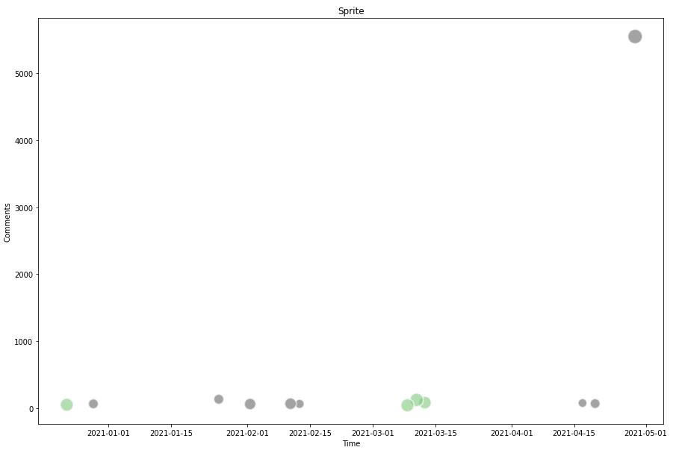
Instagram

Slide 12
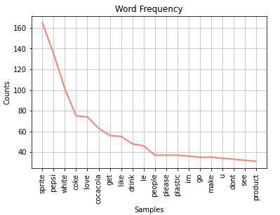
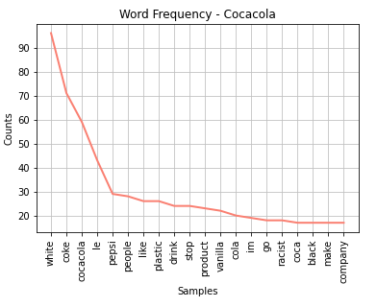
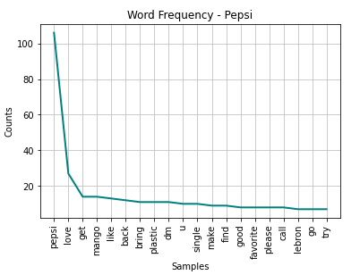
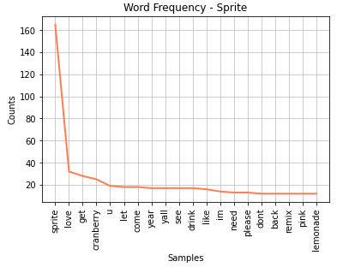
Instagram
The above plots show how frequently each word appears in comments of each brand.

Slide 13
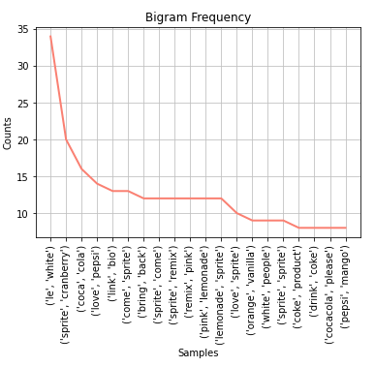
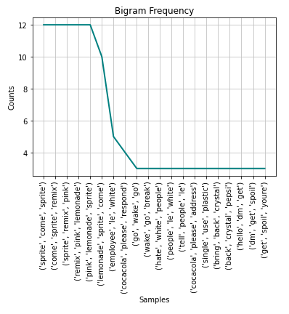
Instagram
The above plots show how frequently each word appears in comments of each brand.

Slide 14
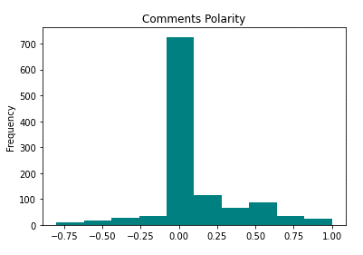
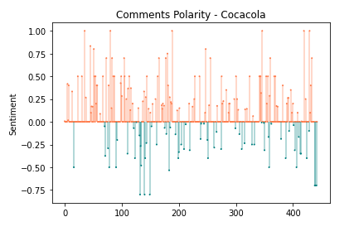
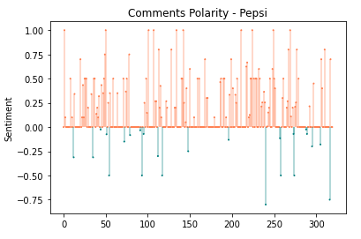
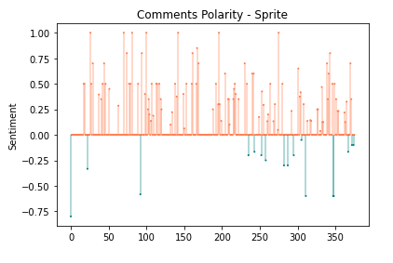
Instagram
The above plots show how frequently each word appears in comments of each brand.

Slide 15
Twitter
The Twitter scrapping is divided into three parts as follows:
5000 most recent tweets and replies for Pepsi, Coca-Cola, and Sprite.
5000 tweets from consumers in the US (highest consumer of soft drinks last year and an English-speaking nation) regarding Pepsi, Coca-Cola, and Sprite.
Tweets from verified accounts since April 2021 talking about Pepsi, Coca-Cola, and Sprite.
Data Extraction:
The above 3 categories sum up to 9 json files scraped using a combination of Tweepy and Twint python libraries. Tweepy is used to fetch detailed information about the company’s twitter profile whereas Twint has been used to scrape tweets and its 35 other attributes without restrictions.

Slide 16
Twitter
Data Cleaning:
The extracted tweets undergo thorough cleaning procedures as follows:
Changing Case – all the tweets are converted to lower case for ease of analysis.
Cleaning Stage 1: Removing URLs, hashtags, mentions, reserved words (RT, FAV), emojis, and smileys from the tweets.
Cleaning Stage 2 - Removing all other characters except for text.
Tokenization – Breaking down the tweets into individual words.
Cleaning Stage 3 – Eliminating stop words from the text to retain valuable information and decrease computation.
Cleaning Stage 4 – Replacing words with their root form using WordNet Lemmatization (without POS tagging)

Slide 17
Twitter
Data Conforming:
Once the tweets are cleaned, they are fed to into a pandas data frame with further transformations as below:
The cleaned tweets are appended to the data frame as a new column.
Based on the cleaned tweets, a tokenized tweets column is added which will further be used for word count frequency.
The extracted tweets have a date attribute which helps to find out the day of the week using the Calendar library. This is appended as day of the week column in the main data frame.
The tweets are checked for polarity (positive, neutral, or negative) utilizing the text blob library and is stored as a metric for the tweets.
In addition to checking for polarity, text blob also gives a subjectivity score helping us to perform robust sentiment analysis.
At the end all the tweets are fed to a Hugging Face Pretrained Transformer to classify tweets as positive and negative accompanied with confidence score.

Slide 18
Twitter
Profile and Activity Analysis:
Coca-Cola has the largest reach/footprint on twitter with 3.3M followers, whereas Pepsi and Sprite have 3M and 0.2M followers, respectively.
Even though Coca-Cola has the highest followers, it is not best when it comes to customer engagement. Out of the 5000 tweets and replies scraped for all 3 brands, Pepsi has the highest customer engagement with 4890 replies with 110 tweets, followed by Coca-Cola at 4578 replies with 422 tweets and Sprite at 3724 replies with 1276 tweets.
Looking at the numbers, it seems that Sprite tends to be the most frequent tweeter but does not indulge much in engaging with customers and followers.

Slide 19
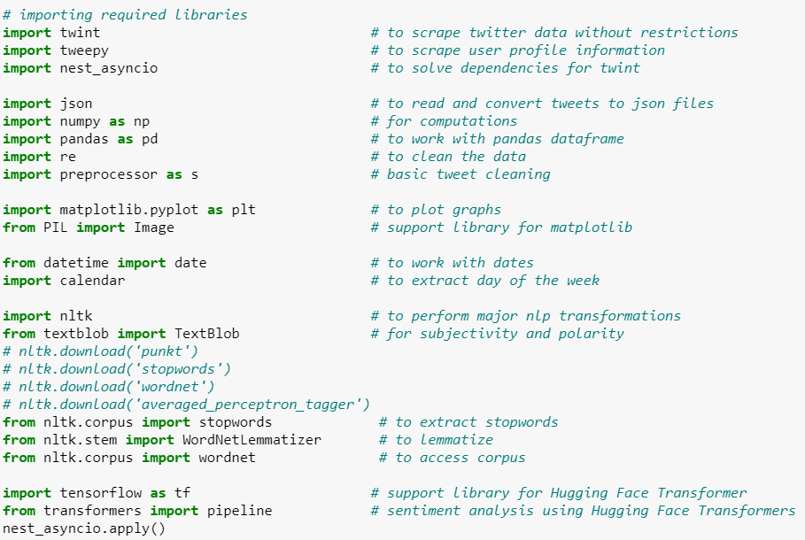
Twitter
Libraries:
Extracting and analyzing twitter data demands conjunction of many packages. The below snapshot of the Jupyter notebook shows the libraries used along with the task they were used for.

Slide 20
Twitter
Having discussed the summary of the project, let us have a look at the analysis. Each class of dataset display the following analysis:
There is no analysis for likes, tweets, and retweets as there is a lot of dominance of certain values in these categories. Due to this property of the data, doing trimmed means was also misleading.
Tweet frequencies using histograms.
Tweets with images (in %).
Day of the week analysis using bar graphs.
Subjectivity and polarity comparison with histograms.
Word count frequency and bigram frequency using line charts.
Hugging Face Transformer sentiment analysis results.

Slide 21
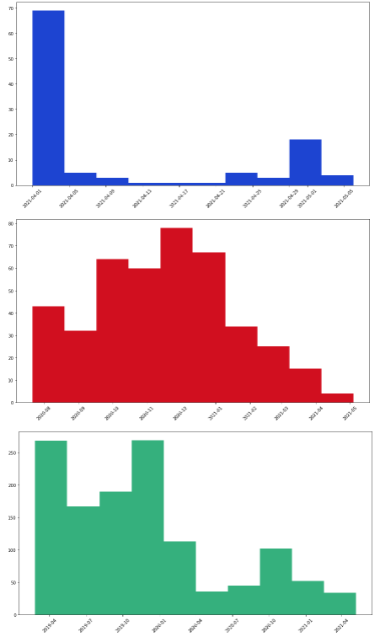
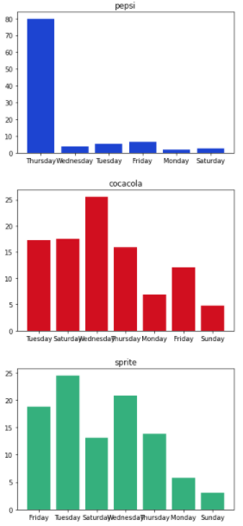
Twitter Analysis Part-1
Histograms showing tweets frequencies inferred from the extracted number of tweets:
% of tweets posted on a particular day of the week
The bar charts given show the distribution of tweets posted by the respective brands based on days of the week. The following results are based on the highest percentage of tweets posted on a given day of the week.
Pepsi – Thursday Coca-Cola – Wednesday Sprite – Tuesday

Slide 22
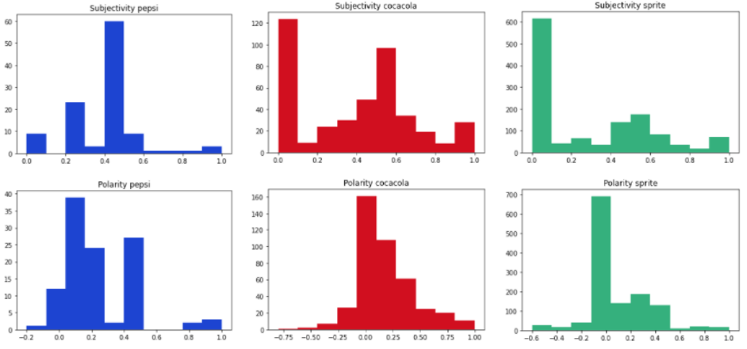
Twitter
Subjectivity and polarity from text blob:
Lots of tweets under Coca-Cola and Sprite are objective which leads to many tweets being neutral in sentiment whereas Pepsi’s tweets are more on the neutral and negative side.
By large, the distributions coming from text blob for Sprite and Coca-Cola look identical.

Slide 23
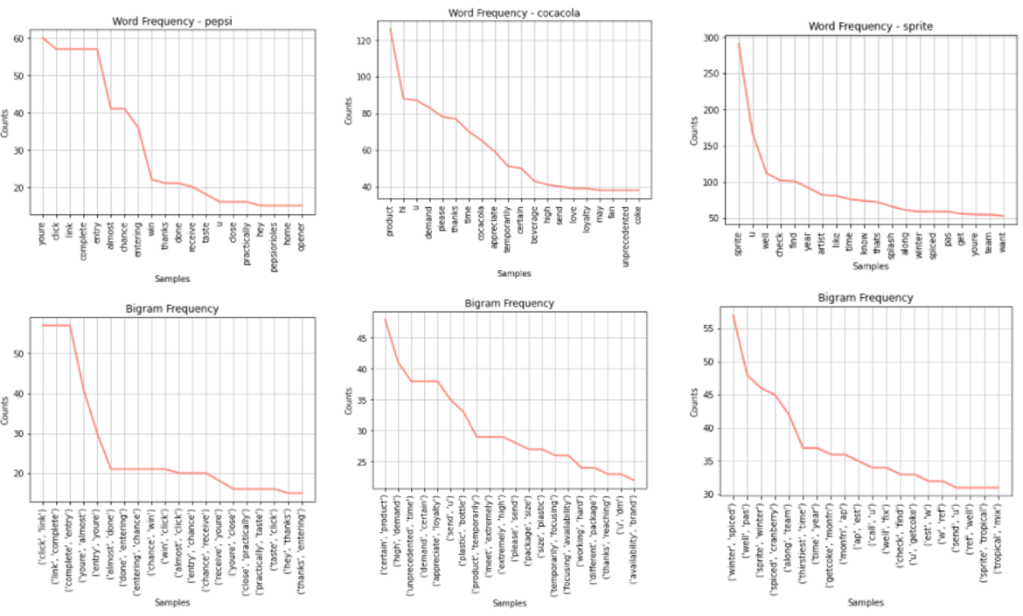
Twitter
Word count frequency and bigram frequency:

Slide 24

Twitter
Transformer analysis:
For fair sentiment analysis, the tweets with subjectivity score greater than 0.5 are selected yielding to the below given results.

Slide 25
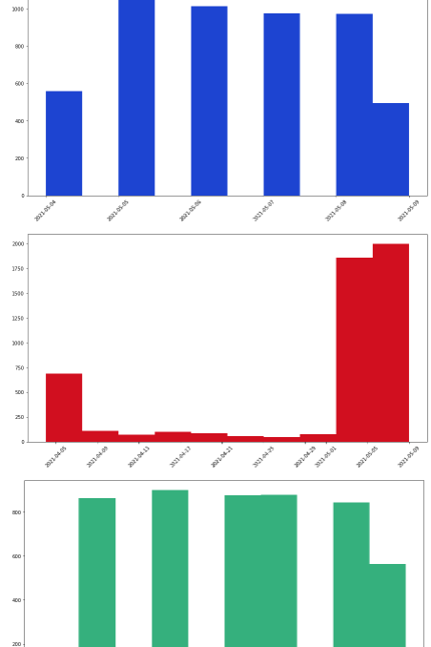
TWITTER ANALYSIS PART-2
Histograms showing tweets frequencies inferred from the extracted number of tweets:

Slide 26
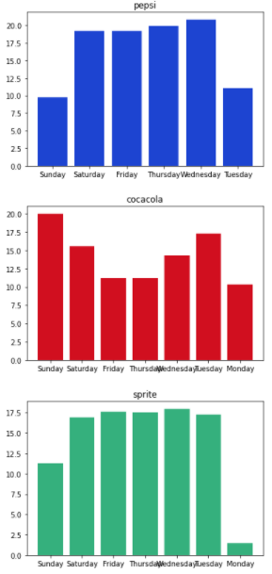
Twitter Analysis Part-2
Weekdays tweet count in the US
The graphs displayed below portray a balanced distribution of tweets throughout the week, so we’ll check for the days with higher number of tweets and look for a possible intersection.

Slide 27
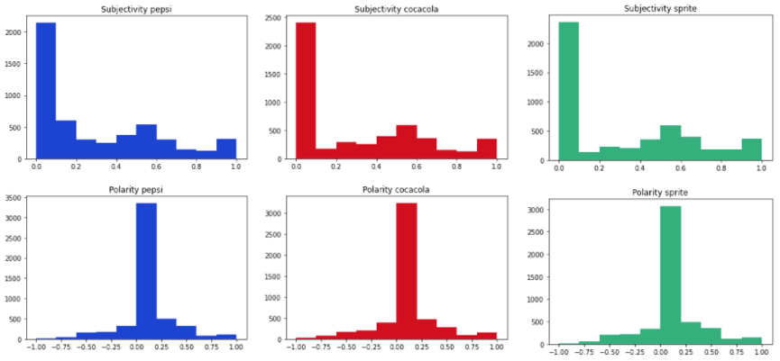
Twitter
Subjectivity and polarity:
For this part, all 3 brands follow identical distribution for subjectivity and polarity derived from text blob.

Slide 28
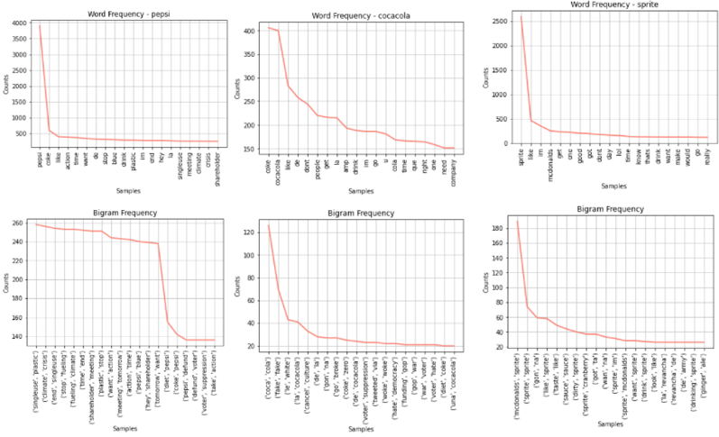
Twitter
Word count frequency and bigram frequency:

Slide 29

TWITter
Transformer analysis:

Slide 30
Twitter Analysis Part-3
With a limit of 5000 and tweets April 2021 onwards containing the name of the company and from a verified account are scraped.
Pepsi has the maximum number of tweets (3022 tweets) from verified users since April 2021 while Coca-Cola and Sprite have 2392 and 622 tweets, respectively.

Slide 31
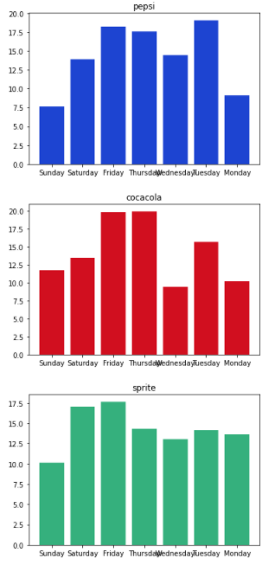
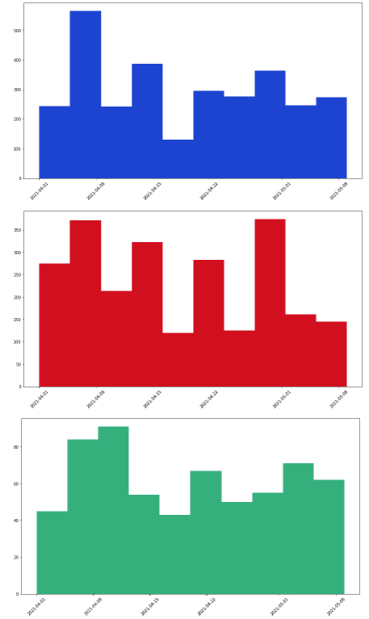
Twitter
% of tweets posted on a particular day of the week
Histograms showing tweets frequencies inferred from the extracted number of tweets:

Slide 32
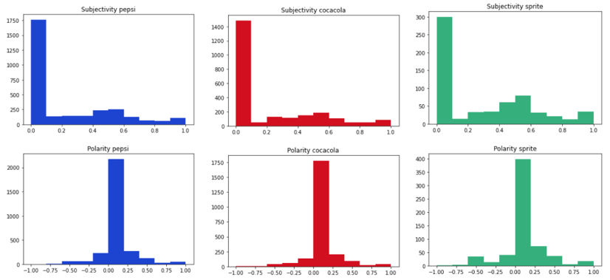
Twitter
Subjectivity and polarity:

Slide 33
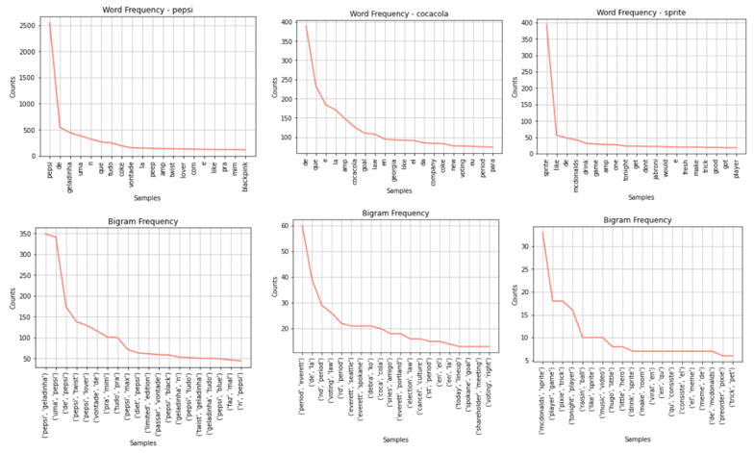
Twitter
Word count frequency and bigram frequency:

Slide 34

TWITTER
Transformer Analysis:

Slide 35
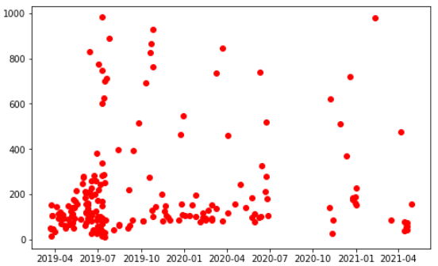
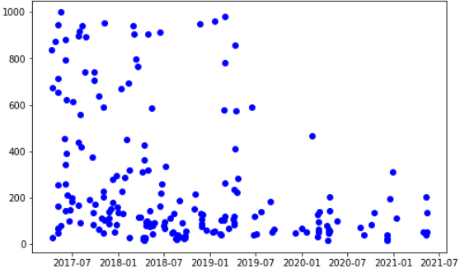
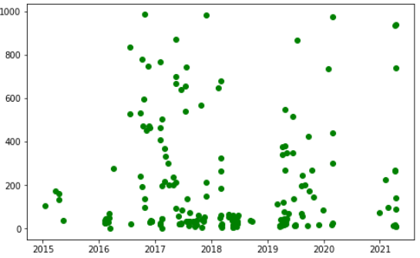
Facebook
The above plots show the likes received on each post of all the

Slide 36
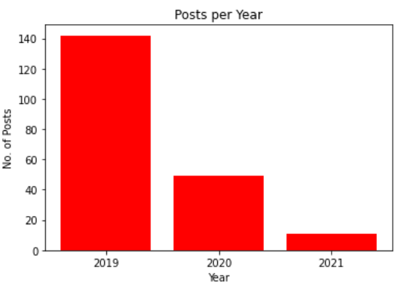
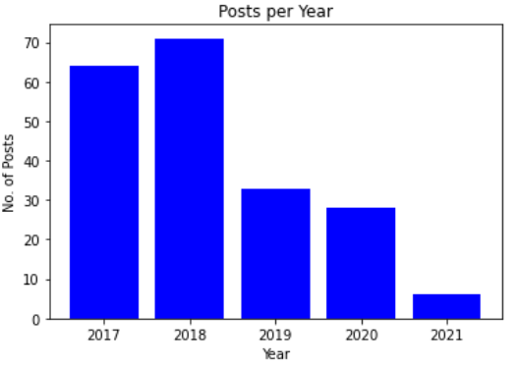
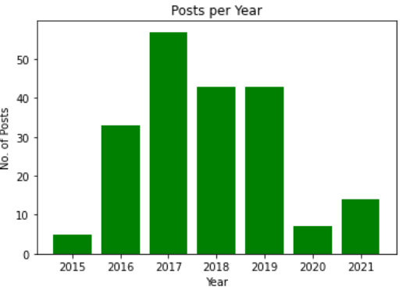
FACEBOOK
Coca-Cola
Pepsi
Sprite
The above comparison number of posts between the 3 brands suggests that Coca-Cola which was most active in 2019 has significantly reduced its activities in the next 2 years compared to Pepsi and Sprite.

Slide 37
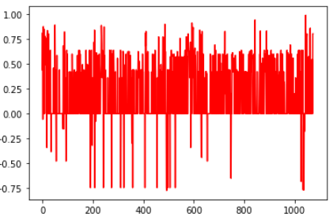
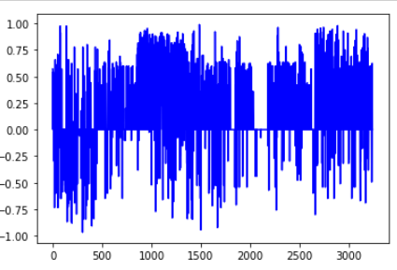
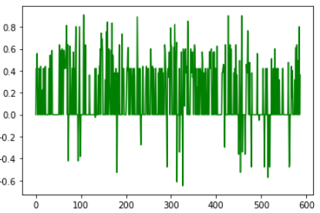
Facebook
1074 comments
3272 comments
587 comments
Overall (Compound) sentiment of each brand

Slide 38
The USERS
The application of this project can be widely implemented by:
Other brands: it can be either competitors with the purpose of tracking strategy or different brands/ companies for the purpose of finding partners or other business opportunities.
Students/ Researchers: to use the results found for study or researching purpose.
Marketers: for strategic insights or understanding marketing pattern of certain brands or even potential influencer searching
Influencers: to find out potential brands profile for further opportunities and better brands understanding

Slide 39
THE USERS
Why should we use sentiment analysis?
Invaluable Marketing: Using sentiment analysis companies and product owners use can use sentiment analysis to know the demand and supply of their products through comments and feedback from the customers.
Identifying key emotional triggers: In psychology and other medical treatment institutions, sentiment analysis can be used to detect whether the individuals’ emotion is normal or abnormal, and based on the data record they can decide person health.

Slide 40
THE USERS
Politics: In the political field, candidates to be elected can use sentiment analysis to predict their political status, to measure people’s acceptance. It can also be used to predict election results for electoral board commissions.
Education: Universities and other higher institutes like colleges can use sentiment analysis to know their student’s feedback and comment, therefore they can take consideration to revise or improve their education curriculum.

Slide 41
Pre-Conditions
Python version 3.7+
Jupyter notebook installation
Installing all used packages and dependencies
Active Twitter developer account
Authentication strings to fetch data through the API.
Having all required JSON files downloaded or download using the command given in the notebook.
Active platforms accounts and developer accounts if applicable.
Instagram scrape needs session ID
Active Facebook account to obtain Page ID of the pages to be scrapped.

Slide 42
Post-conditions
Graphs with different analysis should be printed.
Summary statistics of different columns where mentioned
Transformer analysis and sentiment analysis for different aspects should be printed.
Collected data must be valid.
Data are organized for easy and quick analysis.
Insights are drawn with graph and chart presentations.
Sentiment analysis must give comprehensive insights and results.

Slide 43
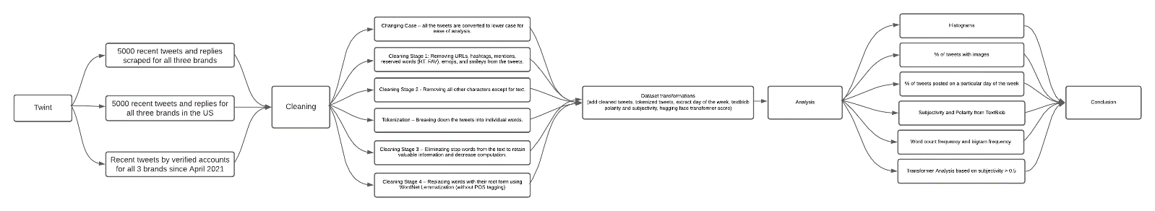
MAIN FLOW DIAGRAM
Collecting data
Inspecting and cleaning data
Performing analysis
Results
Installing requirements

Slide 44
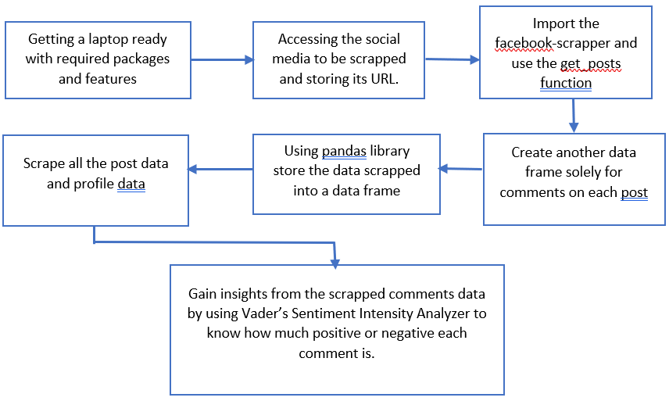
MAIN FLOW DIAGRAM

Slide 45
Ethical issues
For Instagram:
Officially, Instagram strictly prohibits any form of automated data scraping. The risks are:
Content can be stolen and taken advantage of.
Sending too many requests can burden the website traffic and possibly crash the site.
The inner algorithms or data model/structures could be revealed and manipulated.
For Facebook:
Facebook-scraper is an external IP not utilizing the Facebook’s well known Graph API hence too much scraping at once could lead to blocking of you IP address.

Slide 46
Ethical issues
For Twitter:
The following approved and public APIs are used to gather information about the brands:
Tweepy
Twint
Though scraped by default, the project does not utilise PII (Personally Identifiable Information) to perform network analysis or infer from the social relationship the users or the brand share with others. The project solely processes and draws inference from textual tweets leaving out all images, videos and other content sharing formats.
This project abides by the Python Web Scrapping Code of Conduct and DOES NOT,
Download copies of document that are clearly not public.
Share downloaded content illegally.
Share what you cannot.
Overload the server.
Scrape the same data repeatedly.
Violate rules mentioned in the robots.txt file.

Slide 47

CONCLUSION

Slide 48

THANK YOU!!!

